Slide 1
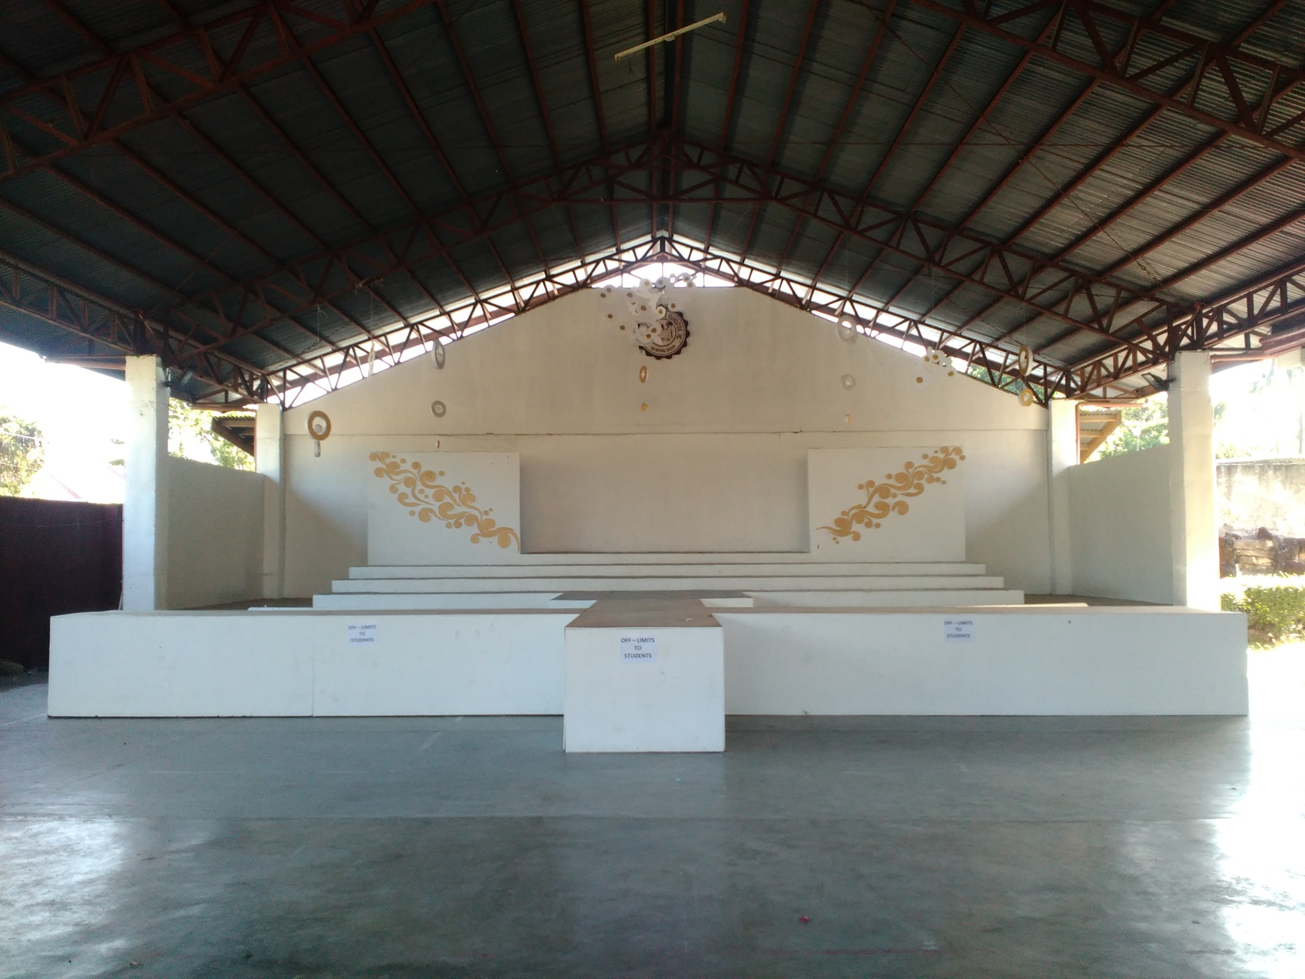
GYMNASIUM

Slide 2
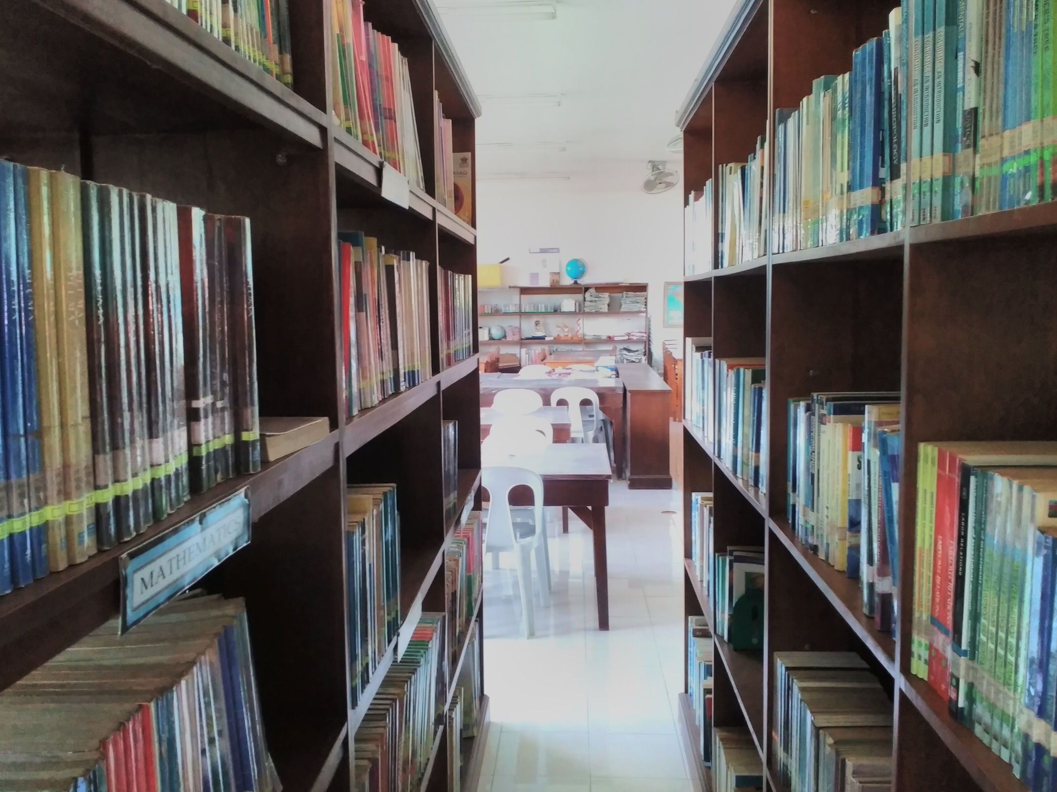
LIBRARY

Slide 3
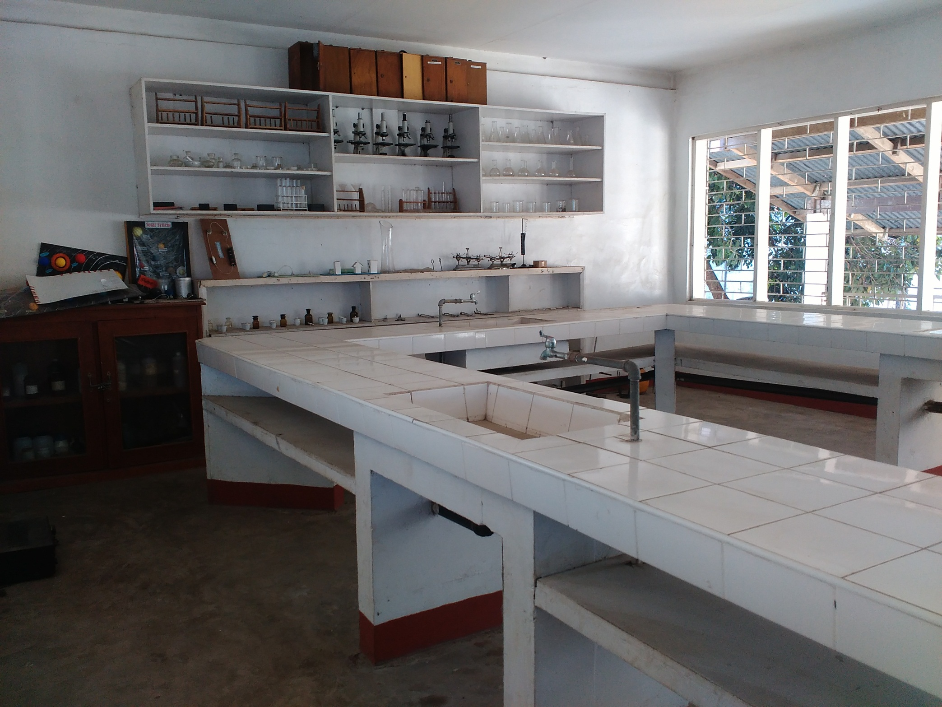
SCIENCE LAB

Slide 4
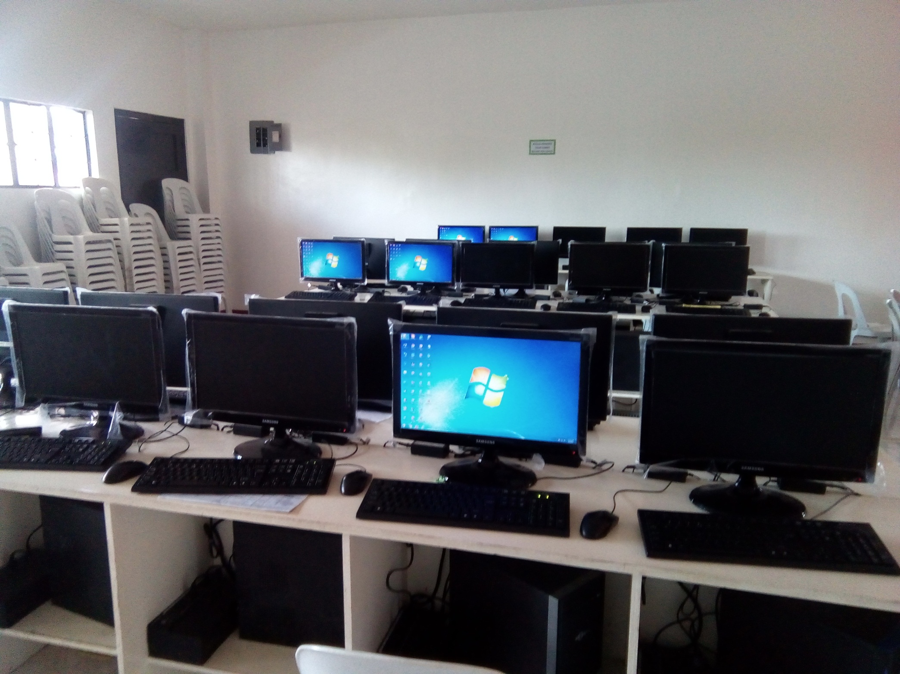
COMPUTER LAB

